Slide 1


RECOMMENDATION SYSTEM
Mainak Ray

Slide 2






Categories Section
Algorithm to solve the problem
Recommendation system
Problem statement
Utility of model
conclusion

Slide 3

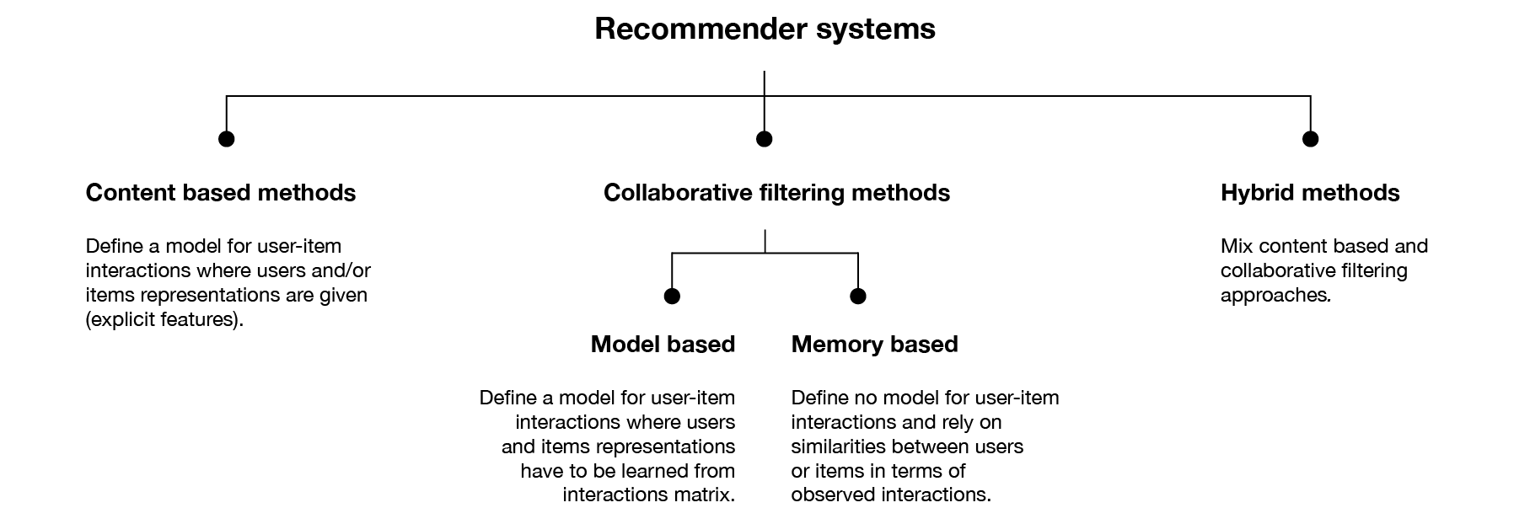
Recommendation system
A subclass of information filtering system that seeks to predict the "rating" or "preference" a user would give to an item.

Slide 4
Problem statements.
we get two problem statements.
a
Recommendation system for clothes
b
Recommendation system for electronic items

Slide 5
for clothes
we get several features in the cloths dataset but to build the recommendation system, we should require user_id and brand name.
Because our intention is to prepare a recommendation system that can recommend similar brands for any kind of attires, so users can compare the price value that is associated with the brand.

Slide 6
For Electronics
we get several features in the electronics dataset but to build the recommendation system, we should require user_id, brand name, and product name.
Because our intention is to prepare a recommendation system that can recommend not only similar brands for the particular electronic item but also it can recommend similar choices of a given product.

Slide 7


Algorithm to solve the problem
Model-based recommendation systems involve building a model based on the dataset of ratings.
Collaborative filtering (CF)
sparse matrices
Unsupervised Nearest Neighbors
The standard method of Collaborative Filtering is known as Nearest Neighborhood algorithm. There are user-based CF and item-based CF
Using sparse matrices to store data that contains a large number of zero-valued elements can both save a significant amount of memory and speed up the processing of that data.
The principle behind nearest neighbor methods is to find a predefined number of training samples closest in distance to the new point, and predict the label from these

Slide 8






UTILITY OF MODEL
No domain knowledge necessary.
The model can help users discover new interests.
To some extent, the system needs only the feedback matrix to train a matrix factorization model

Slide 9











conclusion
The CF method has some disadvantages also as examples Hard to include side features for query/item as well as Cannot handle fresh items though to prepare a user-based recommendation system by which we can use the CF method because it is work on the lazy learner and it is also easy to use and require less feature to train.

Slide 10


